Slide 1
18CSE360T - INFORMATION STORAGE AND MANAGEMENT S - 1 / UNIT - 5
UNIT - 5
SLO-1 :
Cloud Computing : Cloud Enabling Technologies

Slide 2
Drivers for Cloud Computing
Business requirements
  Organizations are under increasing pressure to improve efficiency and transformation of IT processes to achieve more with less
  Better agility and higher availability at reduced expenditure
  Reduced time-to-market
  Accelerated pace of innovation
IT challenges to meet business requirements are:
  Serving customers worldwide round the clock, refreshing technology quickly, faster provisioning of IT resources –
These challenges are addressed with the emergence of cloud computing
all at reduced cost
18CSE360T - INFORMATION STORAGE AND MANAGEMENT S - 1 / UNIT - 5

Slide 3
What is Cloud Computing?
A model for enabling ubiquitous, convenient, on-demand network access to a shared pool of configurable computing resources (e.g., servers, storage, networks, applications, and services) that can be rapidly provisioned and released with minimal management effort or service provider interaction.– NIST
18CSE360T - INFORMATION STORAGE AND MANAGEMENT S - 1 / UNIT - 5

Slide 4
Cloud Enabling Technologies
Enabling technologies of cloud computing
  Grid computing
  utility computing
  virtualization
  service-oriented architecture
18CSE360T - INFORMATION STORAGE AND MANAGEMENT S - 1 / UNIT - 5

Slide 5
Cloud Enabling Technologies
Technologies | Description
Grid computing | Form of distributed computing Enables resources of numerous computers in a network to work on a single task at the same time Grid computing enables parallel computing and is best for large workloads
Utility computing | Service provisioning model that offers computing resources as a metered service Makes computing resources available to customers, as required, and charges them based on usage
18CSE360T - INFORMATION STORAGE AND MANAGEMENT S - 1 / UNIT - 5

Slide 6
Cloud Enabling Technologies
Technologies | Description
Virtualization | Abstracts physical characteristics of IT resources from resource users Enables resource pooling and creating virtual resources from pooled resources Virtualization provides better flexibility for provisioning of IT resources compared to provisioning in a non-virtualized environment
Service-oriented architecture(SOA) | Provides a set of services that can communicate with each other These services work together to perform some activity or simply pass data among services.
18CSE360T - INFORMATION STORAGE AND MANAGEMENT S - 1 / UNIT - 5

Slide 7
18CSE360T - INFORMATION STORAGE AND MANAGEMENT S - 1 / UNIT - 5
SLO-2 :
Characteristics of Cloud Computing

Slide 8
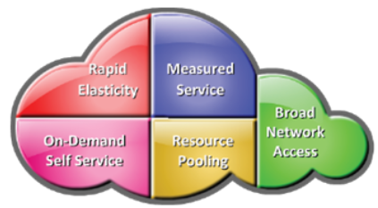
Characteristics of Cloud Computing
Essential Cloud characteristics
  On-demand self-service
  Broad network access
  Resource pooling
  Rapid elasticity
  Measured service
18CSE360T - INFORMATION STORAGE AND MANAGEMENT S - 1 / UNIT - 5

Slide 9
1. On-demand self-service
Enables consumers to unilaterally provision computing capabilities (examples: server time and storage capacity) as needed automatically without requiring human interaction with each service provider
Consumers view service catalogue via a Web-based user interface and use it to request for a service
Consumers can either leverage the “ready-to-use” services or change a few service parameters to customize the services.
18CSE360T - INFORMATION STORAGE AND MANAGEMENT S - 1 / UNIT - 5

Slide 10
2. Broad Network Access
Computing capabilities are available over the network
Computing capabilities are accessed from a broad range of client platforms such as:
  Desktop
  Computer
  Laptop
  Tablet
  Mobile device
18CSE360T - INFORMATION STORAGE AND MANAGEMENT S - 1 / UNIT - 5

Slide 11
3. Resource Pooling
Provider’s computing resources are pooled to serve multiple consumers using a multitenant model
Virtual resources dynamically assigned and reassigned according to consumer demand
There is a sense of location independence in that the customer generally has no control or knowledge over the exact location of the provided resources.
But may be able to specify location at a higher level of abstraction (for example, country, state, or data center).
Examples of resources include storage, processing, memory, and network bandwidth.
18CSE360T - INFORMATION STORAGE AND MANAGEMENT S - 1 / UNIT - 5

Slide 12
4. Rapid Elasticity
Computing capabilities can be elastically provisioned and released
Computing capabilities are scaled rapidly, commensurate with consumer’s demand
For example,
  an organization might require double the number of web and application servers for a specific duration to accomplish a specific task.
  For the remaining period, they might want to release idle server resources to cut down the expenses.
  The cloud enables consumers to grow and shrink the demand for resources dynamically
18CSE360T - INFORMATION STORAGE AND MANAGEMENT S - 1 / UNIT - 5

Slide 13
5. Measured Service
Cloud computing provides a metering system that continuously monitors resource consumption and generates reports
  Resource usage can be monitored, controlled, and reported, providing transparency for both the provider and consumer of the utilized service
18CSE360T - INFORMATION STORAGE AND MANAGEMENT S - 1 / UNIT - 5

Slide 14
SLO – 1:
Benefits of Cloud Computing
18CSE360T - INFORMATION STORAGE AND MANAGEMENT S - 2 / UNIT - 5

Slide 15
Cloud computing offers the following key benefits:
Reduced IT cost:
  Cloud services can be purchased based on pay-per-use or subscription pricing.
  This reduces or eliminates the consumer’s IT capital expenditure (CAPEX).
Business agility:
  Cloud computing provides the capability to allocate and scale computing capacity quickly.
  Cloud computing can reduce the time required to provision and deploy new applications and services from months to minutes.
  This enables businesses to respond more quickly to market changes and reduce time-to-market.
18CSE360T - INFORMATION STORAGE AND MANAGEMENT S - 2 / UNIT - 5

Slide 16
Benefits of Cloud Computing
Flexible scaling:
  Cloud computing enables consumers to scale up, scale down, scale out, or scale in the demand for computing resources easily.
  Consumers can unilaterally and automatically scale computing resources without any interaction with cloud service providers.
  The flexible service provisioning capability of cloud computing often provides a sense of unlimited scalability to the cloud service consumers.
18CSE360T - INFORMATION STORAGE AND MANAGEMENT S - 2 / UNIT - 5

Slide 17
Benefits of Cloud Computing…
High availability:
  Cloud computing has the capability to ensure resource availability at varying levels depending on the consumer’s policy and priority.
  Redundant infrastructure components (servers, network paths, and storage equipment, along with clustered software) enable fault tolerance for cloud deployments.
  These techniques can encompass multiple data centers located in different geographic regions, which prevents data unavailability due to regional failures.
18CSE360T - INFORMATION STORAGE AND MANAGEMENT S - 2 / UNIT - 5

Slide 18
SLO – 2 :
Cloud Service Models
18CSE360T - INFORMATION STORAGE AND MANAGEMENT S - 2 / UNIT - 5

Slide 19
Cloud Service Models
According to NIST, cloud service offerings are classified primarily into three models:
Infrastructure-as-a-Service (IaaS)
Platform-as-a-Service (PaaS)
Software-as-a-Service (SaaS)
18CSE360T - INFORMATION STORAGE AND MANAGEMENT S - 2 / UNIT - 5

Slide 20
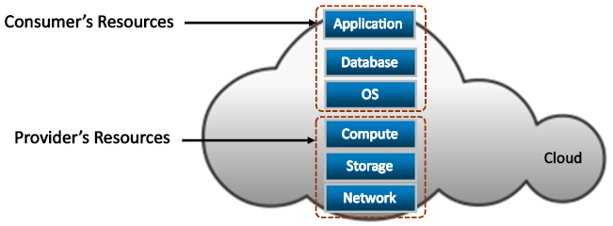
Infrastructure-as-a-Service
Consumers deploy their software, including OS and application on provider’s infrastructure
  Computing resources such as processing power, memory, storage, and networking components are offered as service
  Example: Amazon Elastic Compute Cloud
Consumers have control over the OSs and deployed applications
18CSE360T - INFORMATION STORAGE AND MANAGEMENT S - 2 / UNIT - 5

Slide 21
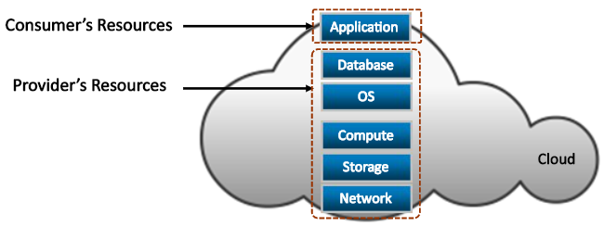
Platform-as-a-Service
Consumers deploy consumer-created or acquired applications onto provider’s computing platform
Computing platform is offered as a service
Example: Google App Engine and Microsoft Windows Azure Platform
Consumer has control over deployed applications
18CSE360T - INFORMATION STORAGE AND MANAGEMENT S - 2 / UNIT - 5

Slide 22
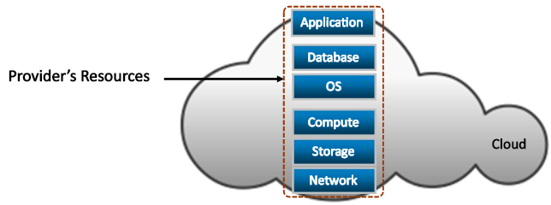
Software-as-a-Service
Consumers use provider’s applications running on the cloud infrastructure
  Applications are offered as a service
  Examples: EMC Mozy and Salesforce.com
Service providers exclusively manage computing infrastructure and software to support services
The consumers may be allowed to change a few application configuration settings to customize the applications.
18CSE360T - INFORMATION STORAGE AND MANAGEMENT S - 2 / UNIT - 5

Slide 23
SLO – 1 :
Cloud Deployment Models
18CSE360T - INFORMATION STORAGE AND MANAGEMENT S - 3 / UNIT - 5

Slide 24
Cloud Deployment Models
According to NIST, cloud computing is classified into four deployment models
  public
  private
  community
  hybrid
  - which provide the basis for how cloud infrastructures are constructed and consumed.
18CSE360T - INFORMATION STORAGE AND MANAGEMENT S - 3 / UNIT - 5

Slide 25
1. Public Cloud
In a public cloud model, the cloud infrastructure is provisioned for open use by the general public.
It may be owned, managed, and operated by a business, academic, or government organization, or some combination of them. It exists on the premises of the cloud provider.
Consumers use the cloud services offered by the providers via the Internet and pay metered usage charges or subscription fees.
18CSE360T - INFORMATION STORAGE AND MANAGEMENT S - 3 / UNIT - 5

Slide 26
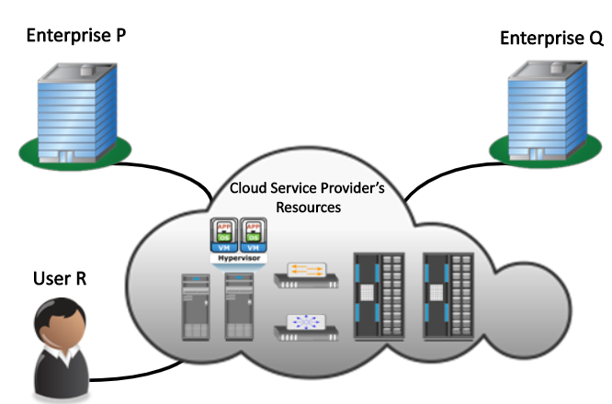
Public cloud…
18CSE360T - INFORMATION STORAGE AND MANAGEMENT S - 3 / UNIT - 5

Slide 27
Public Cloud…
An advantage of the public cloud is its low capital cost with enormous scalability.
However, for consumers, these benefits come with certain risks: no control over the resources in the cloud, the security of confidential data, network performance, and interoperability issues.
Popular public cloud service providers are Amazon, Google, and Salesforce.com.
18CSE360T - INFORMATION STORAGE AND MANAGEMENT S - 3 / UNIT - 5

Slide 28
2. Private Cloud
In a private cloud model, the cloud infrastructure is provisioned for exclusive use by a single organization comprising multiple consumers (for example, business units).
It may be owned, managed, and operated by the organization, a third party, or some combination of them, and it may exist on or off premises.
18CSE360T - INFORMATION STORAGE AND MANAGEMENT S - 3 / UNIT - 5

Slide 29
Private Cloud…
Following are two variations to the private cloud model:
On-premise private cloud:
  The on-premise private cloud, also known as internal cloud, is hosted by an organization within its own data centers
  Enables organizations to standardize their cloud service management processes and security, although this model has limitations in terms of size and resource scalability.
  Organizations would also need to incur the capital and operational costs for the physical resources.
  This is best suited for organizations that require complete control over their applications, infrastructure configurations, and security mechanisms.
18CSE360T - INFORMATION STORAGE AND MANAGEMENT S - 3 / UNIT - 5

Slide 30
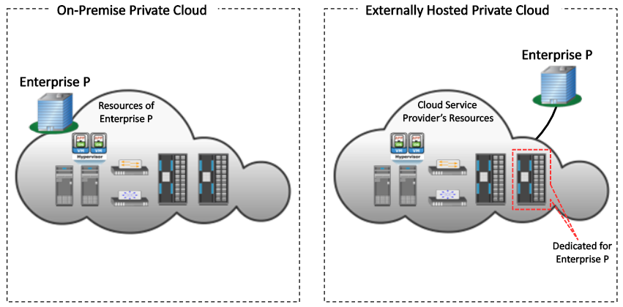
On-premise and externally hosted private clouds
18CSE360T - INFORMATION STORAGE AND MANAGEMENT S - 3 / UNIT - 5

Slide 31
Private Cloud…
2. Externally hosted private cloud:
  This type of private cloud is hosted external to an organization and is managed by a third party organization.
  The third-party organization facilitates an exclusive cloud environment for a specific organization with full guarantee of privacy and confidentiality
18CSE360T - INFORMATION STORAGE AND MANAGEMENT S - 3 / UNIT - 5

Slide 32
3. Community Cloud
In a community cloud model, the cloud infrastructure is provisioned for exclusive use by a specific community of consumers from organizations that have shared concerns
  Example : mission, security requirements, policy, and compliance considerations
It may be owned, managed, and operated by one or more of the organizations in the community, a third party, or some combination of them, and it may exist on or off premises
18CSE360T - INFORMATION STORAGE AND MANAGEMENT S - 3 / UNIT - 5

Slide 33
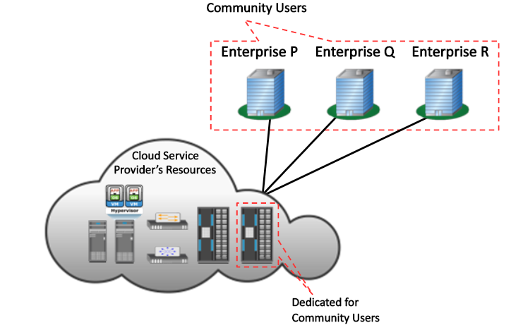
Community cloud…
18CSE360T - INFORMATION STORAGE AND MANAGEMENT S - 3 / UNIT - 5

Slide 34
Community Cloud…
In a community cloud, the costs spread over to fewer consumers than a public cloud.
Hence, this option is more expensive but might offer a higher level of privacy, security, and compliance.
Example : government agencies.
If various agencies within the government operate under similar guidelines, they could all share the same infrastructure and lower their individual agency’s investment.
18CSE360T - INFORMATION STORAGE AND MANAGEMENT S - 3 / UNIT - 5

Slide 35
4. Hybrid Cloud
In a hybrid cloud model, the cloud infrastructure is a composition of two or more distinct cloud infrastructures (private, community, or public) that remain unique entities
The hybrid model allows an organization to deploy less critical applications and data to the public cloud, leveraging the scalability and cost-effectiveness of the public cloud.
The organization’s mission-critical applications and data remain on the private cloud that provides greater security.
18CSE360T - INFORMATION STORAGE AND MANAGEMENT S - 3 / UNIT - 5

Slide 36

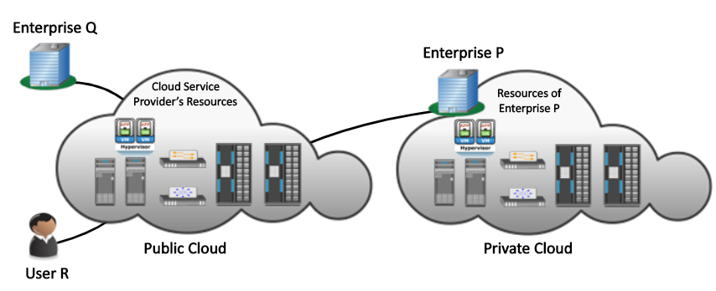
Hybrid Cloud
18CSE360T - INFORMATION STORAGE AND MANAGEMENT S - 3 / UNIT - 5

Slide 37
SLO – 2 :
Cloud Infrastructure Mechanisms :
Logical Network Perimeter
18CSE360T - INFORMATION STORAGE AND MANAGEMENT S - 3 / UNIT - 5

Slide 38
Cloud infrastructure mechanisms
  Cloud infrastructure mechanisms are foundational building blocks of cloud environments that establish primary artifacts to form the basis of fundamental cloud technology architecture
Cloud infrastructure mechanisms are,
      Logical Network Perimeter
      Virtual Server
      Cloud Storage Device
      Cloud Usage Monitor
      Resource Replication
      Ready-Made Environment
  Not all of these mechanisms are necessarily broad-reaching, nor does each establish an individual architectural layer
  Instead, they should be viewed as core components that are common to cloud platforms
18CSE360T - INFORMATION STORAGE AND MANAGEMENT S - 3 / UNIT - 5

Slide 39
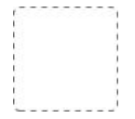
1. Logical Network Perimeter
Defined as the isolation of a network environment from the rest of a communications network.
  the logical network perimeter establishes a virtual network boundary that can encompass and isolate a group of related cloud-based IT resources that may be physically distributed.
The dashed line notation used to indicate the boundary of a logical network perimeter
18CSE360T - INFORMATION STORAGE AND MANAGEMENT S - 3 / UNIT - 5

Slide 40
Logical Network Perimeter…
This mechanism can be implemented to:
    isolate IT resources in a cloud from non-authorized users
    isolate IT resources in a cloud from non-users
    isolate IT resources in a cloud from cloud consumers
    control the bandwidth that is available to isolated IT resources
Logical network perimeters are typically established via network devices that supply and control the connectivity of a data center and are commonly deployed as virtualized IT environments that include:
18CSE360T - INFORMATION STORAGE AND MANAGEMENT S - 3 / UNIT - 5

Slide 41
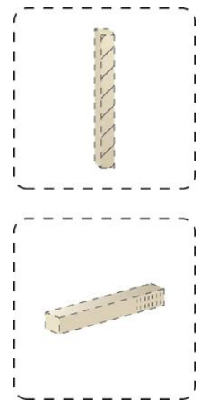
Logical Network Perimeter…
Virtual Firewall – An IT resource that actively filters network traffic to and from the isolated network while controlling its interactions with the Internet.
Virtual Network – Usually acquired through VLANs, this IT resource isolates the network environment within the data center infrastructure.
The symbols used to represent a virtual firewall (top) and a virtual network (bottom).
18CSE360T - INFORMATION STORAGE AND MANAGEMENT S - 3 / UNIT - 5

Slide 42
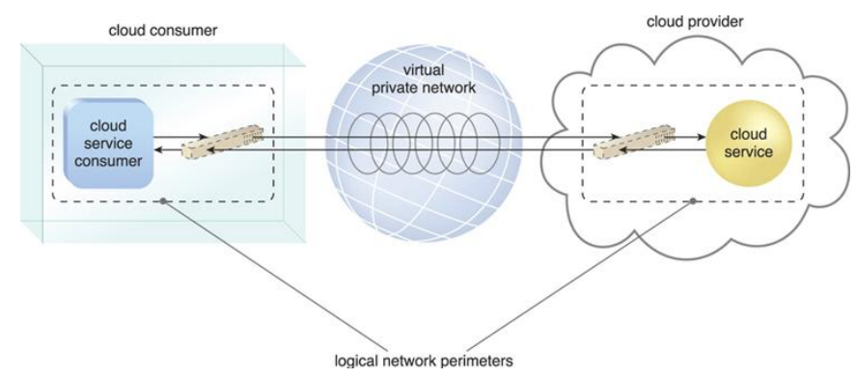
Two logical network perimeters surround the cloud consumer and cloud provider environments
Figure depicts a scenario in which one logical network perimeter contains a cloud consumer’s on-premise environment, while another contains a cloud provider’s cloud-based environment. These perimeters are connected through a VPN that protects communications, since the VPN is typically implemented by point-to-point encryption of the data packets sent between the communicating endpoints.
18CSE360T - INFORMATION STORAGE AND MANAGEMENT S - 3 / UNIT - 5

Slide 43
SLO – 4 & 5 :
Virtual Server, Cloud Storage Device
18CSE360T - INFORMATION STORAGE AND MANAGEMENT S – 4 & 5 / UNIT - 5

Slide 44
2. Virtual Server
A virtual server is a form of virtualization software that emulates a physical server
Virtual servers are used by cloud providers to share the same physical server with multiple cloud consumers by providing cloud consumers with individual virtual server instances.
Figure shows three virtual servers being hosted by two physical servers.
18CSE360T - INFORMATION STORAGE AND MANAGEMENT S – 4 & 5 / UNIT - 5

Slide 45
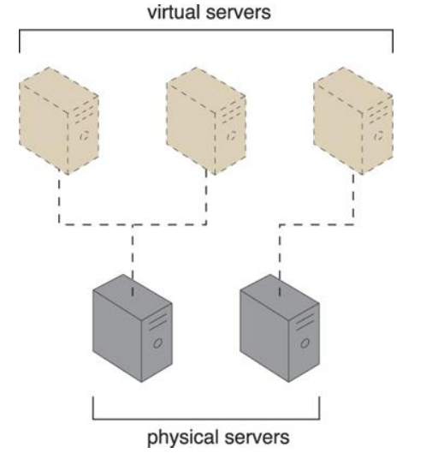
The first physical server hosts two virtual servers, while the second physical server hosts one virtual server
18CSE360T - INFORMATION STORAGE AND MANAGEMENT S – 4 & 5 / UNIT - 5

Slide 46
Virtual Server…
The virtual server represents the most foundational building block of cloud environments.
Each virtual server can host numerous IT resources, cloud-based solutions, and various other cloud computing mechanisms.
The instantiation of virtual servers from image files is a resource allocation process that can be completed rapidly and on-demand.
Cloud consumers that install or lease virtual servers can customize their environments independently from other cloud consumers that may be using virtual servers hosted by the same underlying physical server.
Figure depicts a virtual server that hosts a cloud service being accessed by Cloud Service Consumer B, while Cloud Service Consumer A accesses the virtual server directly to perform an administration task.
18CSE360T - INFORMATION STORAGE AND MANAGEMENT S – 4 & 5 / UNIT - 5

Slide 47
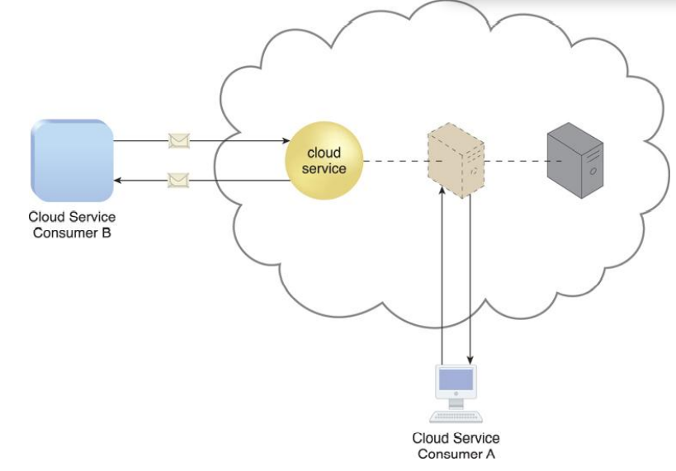
A virtual server hosts an active cloud service and is further accessed by a cloud consumer for administrative purposes
18CSE360T - INFORMATION STORAGE AND MANAGEMENT S – 4 & 5 / UNIT - 5

Slide 48
3. Cloud Storage Device
The cloud storage device mechanism represents storage devices that are designed specifically for cloud-based provisioning.
Instances of these devices can be virtualized
Provide fixed-increment capacity allocation in support of the pay-per-use mechanism
Cloud storage devices can be exposed for remote access via cloud storage services.
18CSE360T - INFORMATION STORAGE AND MANAGEMENT S – 4 & 5 / UNIT - 5

Slide 49
Cloud Storage Device
A primary concern related to cloud storage is the security, integrity, and confidentiality of data.
Another issue applies specifically to the performance of large databases.
LANs provide locally stored data with network reliability and latency levels that are superior to those of WANs.
18CSE360T - INFORMATION STORAGE AND MANAGEMENT S – 4 & 5 / UNIT - 5

Slide 50
Cloud Storage Device
Cloud Storage Levels
Cloud storage device mechanisms provide common logical units of data storage, such as:
Files – Collections of data are grouped into files that are located in folders.
Blocks – The lowest level of storage and the closest to the hardware, a block is the smallest unit of data that is still individually accessible.
Datasets – Sets of data are organized into a table- based, delimited, or record format.
Objects – Data and its associated metadata are organized as Web-based resources.
Each of these data storage levels is commonly associated with a certain type of technical interface which corresponds to a particular type of cloud storage device and cloud storage service used to expose its API (Figure).
18CSE360T - INFORMATION STORAGE AND MANAGEMENT S – 4 & 5 / UNIT - 5

Slide 51
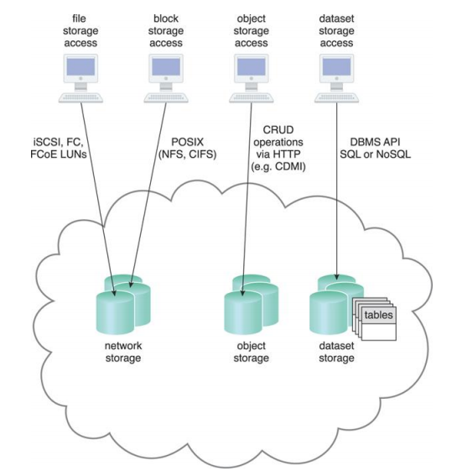
Different cloud service consumers utilize different technologies to interface with virtualized cloud storage devices. (Adapted from the CDMI Cloud Storage Reference Model.)
18CSE360T - INFORMATION STORAGE AND MANAGEMENT S – 4 & 5 / UNIT - 5

Slide 52
Network Storage Interfaces
Legacy network storage most commonly falls under the category of network storage interfaces.
It includes storage devices in compliance with industry standard protocols, such as,
  SCSI for storage blocks
  Server Message Block (SMB),
  Common Internet File System (CIFS)
  Network File System (NFS) for file and network storage.
Storing individual data in separate files and organized into folders and subfolders.
Original files are often replaced by the new files that are created when data has been modified.
18CSE360T - INFORMATION STORAGE AND MANAGEMENT S – 4 & 5 / UNIT - 5

Slide 53
Network Storage Interfaces
When a cloud storage device mechanism is based on this type of interface, its data searching and extraction performance will tend to be suboptimal.
Block storage requires data to be in a fixed format (known as a data block), which is the smallest unit that can be stored and accessed and the storage format closest to hardware.
Using either the logical unit number (LUN) or virtual volume block-level storage will typically have better performance than file-level storage.
18CSE360T - INFORMATION STORAGE AND MANAGEMENT S – 4 & 5 / UNIT - 5

Slide 54
Object Storage Interfaces
Various types of data can be referenced and stored as Web resources. This is referred to as object storage, which is based on technologies that can support a range of data and media types.
Cloud Storage Device mechanisms that implement this interface can typically be accessed via REST or Web service-based cloud services using HTTP as the prime protocol.
18CSE360T - INFORMATION STORAGE AND MANAGEMENT S – 4 & 5 / UNIT - 5

Slide 55
Database Storage Interfaces
Cloud storage device mechanisms based on database storage interfaces typically support a query language in addition to basic storage operations.
This classification of storage interface is divided into two main categories according to storage structure, as follows.
Relational Data Storage
Traditionally, many on-premise IT environments store data using relational databases or relational database management systems (RDBMSs).
Relational databases (or relational storage devices) rely on tables to organize similar data into rows and columns.
Tables can have relationships with each other to give the data increased structure, to protect data integrity, and to avoid data redundancy (which is referred to as data normalization).
Working with relational storage commonly involves the use of the industry standard Structured Query Language (SQL).
18CSE360T - INFORMATION STORAGE AND MANAGEMENT S – 4 & 5 / UNIT - 5

Slide 56
Database Storage Interfaces
A cloud storage device mechanism implemented using relational data storage could be based on any number of commercially available database products,
  such as IBM DB2, Oracle Database, Microsoft SQL Server, and MySQL.
Challenges with cloud-based relational databases commonly pertain to scaling and performance.
Scaling a relational cloud storage device vertically can be more complex and cost-ineffective than horizontal scaling.
Databases with complex relationships and/or containing large volumes of data can be afflicted with higher processing overhead and latency, especially when accessed remotely via cloud services.
18CSE360T - INFORMATION STORAGE AND MANAGEMENT S – 4 & 5 / UNIT - 5

Slide 57
Database Storage Interfaces
2. Non-Relational Data Storage
Non-relational storage (also commonly referred to as NoSQL storage) moves away from the traditional relational database model in that it establishes a “looser” structure for stored data with less emphasis on defining relationships and realizing data normalization.
The primary motivation for using non-relational storage is to avoid the potential complexity and processing overhead that can be imposed by relational databases.
Also, non-relational storage can be more horizontally scalable than relational storage.
18CSE360T - INFORMATION STORAGE AND MANAGEMENT S – 4 & 5 / UNIT - 5

Slide 58
Database Storage Interfaces
Non-relational repositories don’t tend to support relational database functions, such as transactions or joins.
Normalized data exported into a non-relational storage repository will usually become denormalized, meaning that the size of the data will typically grow.
Cloud providers often offer non-relational storage that provides scalability and availability of stored data over multiple server environments.
However, many non-relational storage mechanisms are proprietary and therefore can severely limit data portability.
18CSE360T - INFORMATION STORAGE AND MANAGEMENT S – 4 & 5 / UNIT - 5

Slide 59
SLO – 1 :
Cloud Usage Monitor
18CSE360T - INFORMATION STORAGE AND MANAGEMENT S – 4 & 5 / UNIT - 5

Slide 60
4. Cloud Usage Monitor
The cloud usage monitor mechanism is a lightweight and autonomous software program responsible for collecting and processing IT resource usage data.
Three common agent-based implementation formats:
  Monitoring Agent
  Resource Agent
  Polling Agent
Each can be designed to forward collected usage data to a log database for postprocessing and reporting purposes.
18CSE360T - INFORMATION STORAGE AND MANAGEMENT S – 6 / UNIT - 5

Slide 61
Cloud Usage Monitor
1. Monitoring Agent
A monitoring agent is an intermediary, event-driven program that exists as a service agent and resides along existing communication paths to transparently monitor and analyze dataflows (Figure).
This type of cloud usage monitor is commonly used to measure network traffic and message metrics.
18CSE360T - INFORMATION STORAGE AND MANAGEMENT S – 6 / UNIT - 5

Slide 62
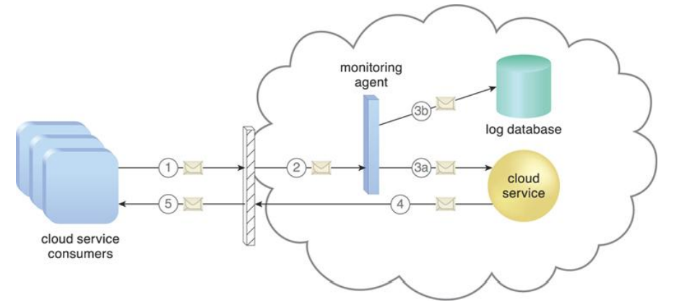
Cloud Usage Monitor
A cloud service consumer sends a request message to a cloud service (1). The monitoring agent intercepts the message to collect relevant usage data (2) before allowing it to continue to the cloud service (3a). The monitoring agent stores the collected usage data in a log database (3b). The cloud service replies with a response message (4) that is sent back to the cloud service consumer without being intercepted by the monitoring agent (5).
18CSE360T - INFORMATION STORAGE AND MANAGEMENT S – 6 / UNIT - 5

Slide 63
Cloud Usage Monitor
2. Resource Agent
A resource agent is a processing module that collects usage data by having event-driven interactions with specialized resource software (Figure).
This module is used to monitor usage metrics based on pre-defined, observable events at the resource software level, such as initiating, suspending, resuming, and vertical scaling.
18CSE360T - INFORMATION STORAGE AND MANAGEMENT S – 6 / UNIT - 5

Slide 64
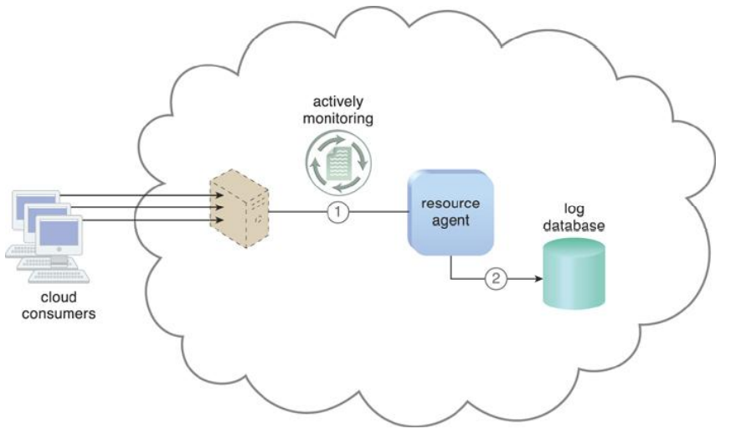
Cloud Usage Monitor
The resource agent is actively monitoring a virtual server and detects an increase in usage (1). The resource agent receives a notification from the underlying resource management program that the virtual server is being scaled up and stores the collected usage data in a log database, as per its monitoring metrics (2).
18CSE360T - INFORMATION STORAGE AND MANAGEMENT S – 6 / UNIT - 5

Slide 65
Cloud Usage Monitor
3. Polling Agent
A polling agent is a processing module that collects cloud service usage data by polling IT resources.
This type of cloud service monitor is commonly used to periodically monitor IT resource status, such as uptime and downtime (Figure).
18CSE360T - INFORMATION STORAGE AND MANAGEMENT S – 6 / UNIT - 5

Slide 66
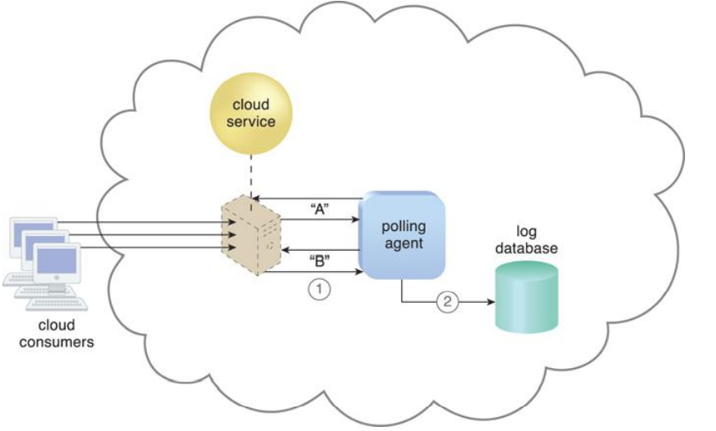
Cloud Usage Monitor
A polling agent monitors the status of a cloud service hosted by a virtual server by sending periodic polling request messages and receiving polling response messages that report usage status “A” after a number of polling cycles, until it receives a usage status of “B” (1), upon which the polling agent records the new usage status in the log database (2).
18CSE360T - INFORMATION STORAGE AND MANAGEMENT S – 6 / UNIT - 5

Slide 67
SLO – 2 :
Resource Replication
18CSE360T - INFORMATION STORAGE AND MANAGEMENT S – 6 / UNIT - 5

Slide 68
5. Resource Replication
Defined as the creation of multiple instances of the same IT resource, replication is typically performed when an IT resource’s availability and performance need to be enhanced.
Virtualization technology is used to implement the resource replication mechanism to replicate cloud-based IT resources (Figure).
18CSE360T - INFORMATION STORAGE AND MANAGEMENT S – 6 / UNIT - 5

Slide 69
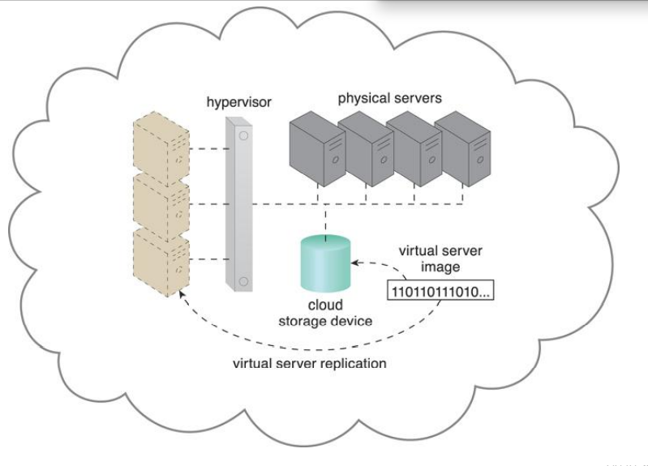
The hypervisor replicates several instances of a virtual server, using a stored virtual server image
18CSE360T - INFORMATION STORAGE AND MANAGEMENT S – 6 / UNIT - 5

Slide 70
SLO – 1 :
Ready-Made Environment
18CSE360T - INFORMATION STORAGE AND MANAGEMENT S – 7 / UNIT - 5

Slide 71
6. Ready-Made Environment
The ready-made environment mechanism (Figure) is a defining component of the PaaS cloud delivery model that represents a predefined, cloud-based platform comprised of a set of already installed IT resources, ready to be used and customized by a cloud consumer.
These environments are utilized by cloud consumers to remotely develop and deploy their own services and applications within a cloud.
Typical readymade environments include pre-installed IT resources, such as databases, middleware, development tools, and governance tools.
18CSE360T - INFORMATION STORAGE AND MANAGEMENT S – 7 / UNIT - 5

Slide 72
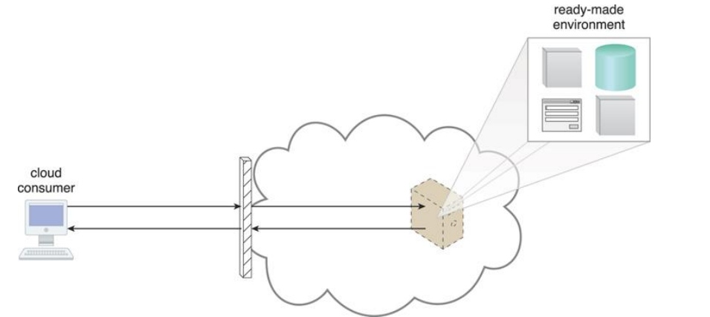
A cloud consumer accesses a ready-made environment hosted on a virtual server
18CSE360T - INFORMATION STORAGE AND MANAGEMENT S – 7 / UNIT - 5

Slide 73
Ready-Made Environment
A ready-made environment is generally equipped with a complete software development kit (SDK) that provides cloud consumers with programmatic access to the development technologies that comprise their preferred programming stacks.
Some cloud providers offer runtime execution environments for cloud services that are based on different runtime performance and billing parameters.
  For example, a front-end instance of a cloud service can be configured to respond to time-sensitive requests more effectively than a back-end instance.
18CSE360T - INFORMATION STORAGE AND MANAGEMENT S – 7 / UNIT - 5

Slide 74
SLO – 2 :
Container
18CSE360T - INFORMATION STORAGE AND MANAGEMENT S – 7 / UNIT - 5

Slide 75
What is a container?
There are a bunch of definitions of what a container is.
  Nigel Poulton’s definition is an “Isolated area of an OS with resource limits usage applied.”
  The Wikipedia’s definition says “containers is a generic term for an operating system level virtualization. There are a number of such implementations including Docker, lxc, and rkt.”
  In the Unix/Linux System Admin book they describe a container to be an isolated group of processes that are restricted to a private root file system and process namespace.
18CSE360T - INFORMATION STORAGE AND MANAGEMENT S – 7 / UNIT - 5

Slide 76
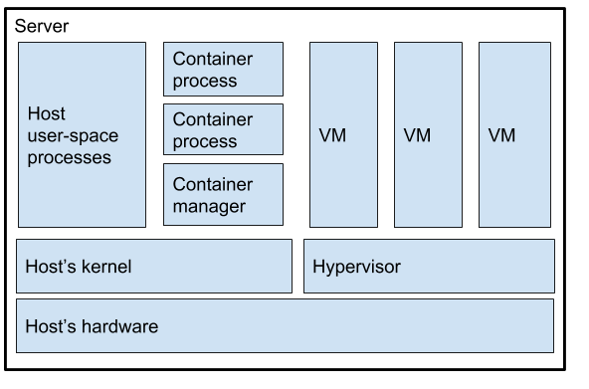
Container
18CSE360T - INFORMATION STORAGE AND MANAGEMENT S – 7 / UNIT - 5

Slide 77
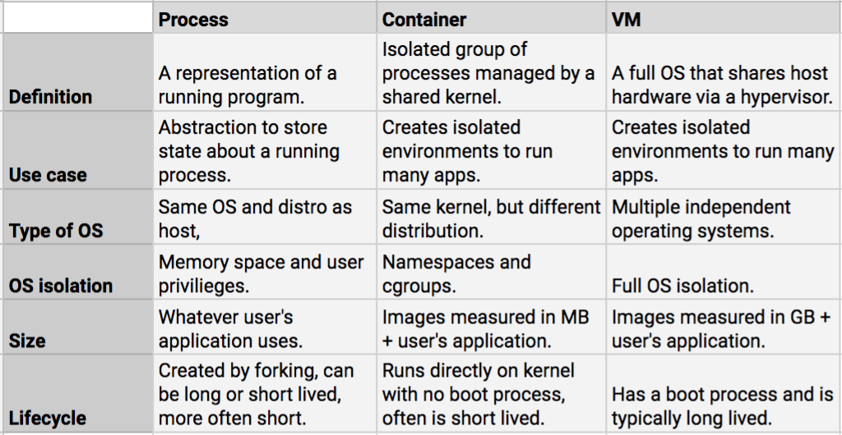
What is the difference between a process, a container, and a VM?
18CSE360T - INFORMATION STORAGE AND MANAGEMENT S – 7 / UNIT - 5

Slide 78
SLO – 1 :
Cloud Challenges
18CSE360T - INFORMATION STORAGE AND MANAGEMENT S – 8 / UNIT - 5

Slide 79
Cloud Challenges
Although there is growing acceptance of cloud computing, both the cloud service consumers and providers have been facing some challenges.
Challenges – Consumer’s Perspective
Cloud Challenges – Provider’s Perspective
18CSE360T - INFORMATION STORAGE AND MANAGEMENT S – 8 / UNIT - 5

Slide 80
Challenges – Consumer’s Perspective
Security and regulation
  Consumers are indecisive to transfer control of sensitive data
  Regulation may prevent organizations from using cloud services
Network latency
  Real time applications may suffer due to network latency and limited bandwidth
Supportability
  Service provider might not support proprietary environments Incompatible hypervisors could impact VM migration
Vendor lock-in
  Lack of standardization across cloud-based platforms
    Restricts consumers from changing their cloud service providers
18CSE360T - INFORMATION STORAGE AND MANAGEMENT S – 8 / UNIT - 5

Slide 81
Cloud Challenges – Provider’s Perspective
Service warranty and service cost
  Resources must be kept ready to meet unpredictable demand
  Hefty penalty, if SLAs are not fulfilled
Complexity in deploying vendor software in the cloud
  Many vendors do not provide cloud-ready software licenses
  Higher cost of cloud-ready software licenses
No standard cloud access interface
  Cloud consumers want open APIs
  Need agreement among cloud providers for standardization
18CSE360T - INFORMATION STORAGE AND MANAGEMENT S – 8 / UNIT - 5

Slide 82
SLO – 2 :
Cloud Adoption Considerations
18CSE360T - INFORMATION STORAGE AND MANAGEMENT S – 8 / UNIT - 5

Slide 83
Cloud Adoption Considerations
Organizations that decide to adopt cloud computing always face this question: “How does the cloud fit the organization’s environment?”
They need to consider various factors before moving their business processes to the cloud.
Even individuals seeking to use cloud services need to understand some cloud adoption considerations.
18CSE360T - INFORMATION STORAGE AND MANAGEMENT S – 8 / UNIT - 5

Slide 84
Selection of a deployment model
Risk versus convenience is a key consideration for deciding on a cloud adoption strategy. This consideration also forms the basis for choosing the right cloud deployment model.
A public cloud is usually preferred by individuals and start-up businesses. For them, the cost reduction offered by the public cloud outweighs the security or availability risks in the cloud.
Small- and medium-sized businesses (SMBs) have a moderate customer base, and any anomaly in customer data and service levels might impact their business.
Therefore, they may not be willing to deploy their tier 1 applications, such as Online Transaction Processing (OLTP), in the public cloud. A hybrid cloud model fits in this case.
18CSE360T - INFORMATION STORAGE AND MANAGEMENT S – 8 / UNIT - 5

Slide 85
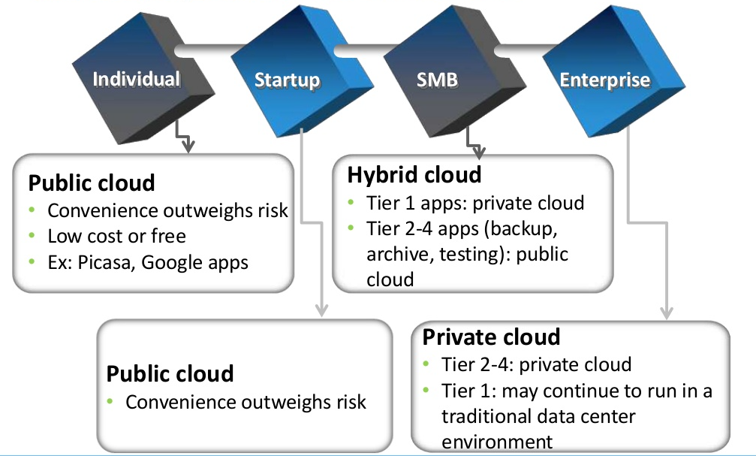
What Deployment Model Fits for You?
18CSE360T - INFORMATION STORAGE AND MANAGEMENT S – 8 / UNIT - 5

Slide 86
Selection of a deployment model
The tier 1 applications should run on the private cloud, whereas less critical applications such as backup, archive, and testing can be deployed in the public cloud.
Enterprises typically have a strong customer base worldwide.
They usually enforce strict security policies to safeguard critical customer data. Because they are financially capable, they might prefer building their own private clouds.
18CSE360T - INFORMATION STORAGE AND MANAGEMENT S – 8 / UNIT - 5

Slide 87
Choosing Applications for Public Cloud
Some key questions to ask before migrating a consumer application to the public cloud:
  Is the application compatible to cloud platform software? Is it a legacy application?
  Is the application proprietary and mission-critical? Does the application provide competitive advantage?
  Is the application workload network traffic intensive? Will application performance be impacted by network latency and limited network bandwidth?
  Does the application communicate with other data center resources or applications?
18CSE360T - INFORMATION STORAGE AND MANAGEMENT S – 8 / UNIT - 5

Slide 88
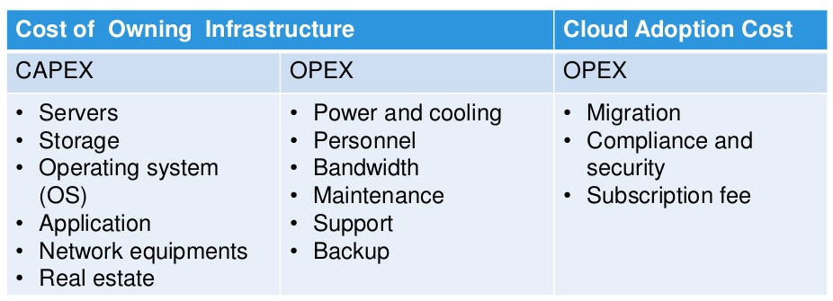
Financial advantage
A careful analysis of financial benefits provides a clear picture about the cost-savings in adopting the cloud.
Compare both the Total Cost of Ownership (TCO) and the Return on Investment (ROI) in the cloud
Requires analysis of financial benefits in adopting cloud
Consider CAPEX (Capital expenditure) and OPEX (Operational expenditure) to deploy and maintain own infrastructure versus cloud-adoption cost
18CSE360T - INFORMATION STORAGE AND MANAGEMENT S – 8 / UNIT - 5

Slide 89
Selection of a cloud service provider:
Some key questions to ask before selecting a provider:
How long and how well has the provider been delivering the services?
How well does the provider meet the organization’s current and future requirements?
How easy is it to add or remove services?
How easy is it to move to another provider, when required?
What happens when the provider upgrades their software? Is it forced on everyone? Can you upgrade on your own schedule?
Does the provider offer the required security services?
Does the provider meet your legal and privacy requirements?
Does the provider have good customer service support?
18CSE360T - INFORMATION STORAGE AND MANAGEMENT S – 8 / UNIT - 5

Slide 90
Service-level agreement (SLA)
Cloud service providers typically mention quality of service (QoS) attributes such as throughput and uptime, along with cloud services.
The QoS attributes are generally part of an SLA, which is the service contract between the provider and the consumers.
The SLA serves as the foundation for the expected level of service between the consumer and the provider.
Before adopting the cloud services, consumers should check whether the QoS attributes meet their requirements.
18CSE360T - INFORMATION STORAGE AND MANAGEMENT S – 8 / UNIT - 5

Slide 91

References
Somasundaram, Gnanasundaram, Alok Shrivastava (2012), Information Storage and Management - Storing, Managing, and Protecting Digital Information in Classic, Virtualized, and Cloud Environments, 2nd Edition, EMC Corporation.
Thomas Erl, “Cloud Computing: Concepts, Technology & Architecture”, Prentice Hall.

